Slide 1


Fundamentals of Management
Eleventh Edition
Chapter 1
Managers and Management in Today’s Workplace
Copyright © 2020, 2017, 2015 Pearson Education, Inc. All Rights Reserved
Notes:
If this PowerPoint presentation contains mathematical equations, you may need to check that your computer has the following installed:
1) Math Type Plugin
2) Math Player (free versions available)
3) NVDA Reader (free versions available)

Slide 2
Learning Objectives
1.1 Tell who managers are and where they work.
1.2 Define management.
1.3 Describe what managers do.
1.4 Explain why it’s important to study management.
1.5 Describe the factors that are reshaping and redefining management.
1.6 Describe the key employability skills gained from studying management that are applicable to your future career, regardless of your major.
Notes:
After studying this chapter, you will be able to:
Tell who managers are and where they work.
Define management.
Describe what managers do.
Explain why it’s important to study management.
Describe the factors that are reshaping and redefining management.
Describe the key employability skills gained from studying management that are applicable to your future career, regardless of your major.

Slide 3
Learning Objective 1.1
Tell who managers are and where they work.

Slide 4
Who Are Managers? Where Do They Work?
Organization
A deliberate collection of people brought together to accomplish some specific purpose
Common Characteristics of Organizations
Goals
People
Structure
Notes:
Managers work in organizations, which we define as a deliberate arrangement of people brought together to accomplish a specific purpose.
Three characteristics that identify an organization are its:
Goals
People, and
Structure
Examples of organizations include:
Your neighborhood convenience store
The Dallas Cowboys football team
Fraternities and sororities
The Cleveland Clinic
Global companies such as Nokia

Slide 5
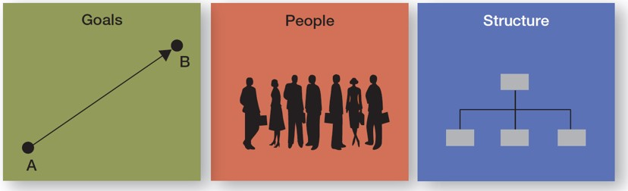
What Three Characteristics Do All Organizations Share?
Exhibit 1.1 Three Characteristics of Organizations
Notes:
Here we see the three common characteristics that organizations share:
Goals, which express the distinct purpose of a particular organization
People, who make decisions and engage in work activities to reach the organization’s goals, and
A deliberate structure, which systematically defines and limits its members’ behavior.

Slide 6
How Are Managers Different from Nonmanagerial Employees?
Nonmanagerial Employees
Work directly on tasks
Not responsible for overseeing others’ work
Managers
Direct and oversee the activities of others
May have work duties not related to overseeing others
Notes:
Members of an organization can be divided into two categories:
Nonmanagerial employees work directly on a task and do not oversee the work of others. Examples include a cashier in a home improvement store or someone who takes your order at a coffee store. They may be called associates, team members, or contributors.
Managers, who direct and oversee the activities of the people in the organization. A manager’s job isn’t about personal achievement—it’s about helping others do their work. This distinction doesn’t mean, however, that managers don’t ever work directly on tasks.

Slide 7
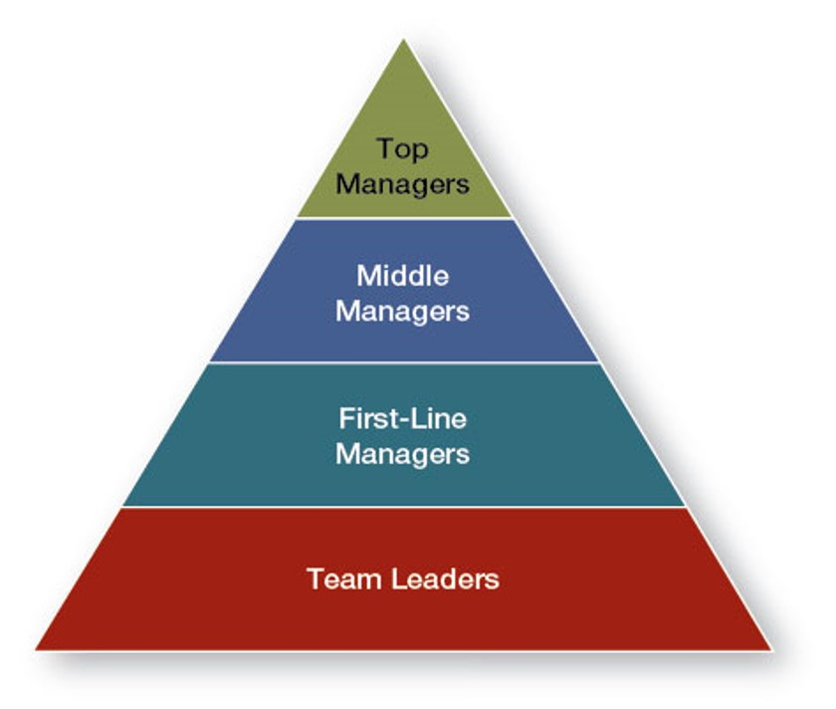
What Titles Do Managers Have? (1 of 2)
Exhibit 1.2 Management Levels
Notes:
Managers in an organization can have a variety of titles. Managers are usually classified as top, middle, first-line, or team leaders.

Slide 8
What Titles Do Managers Have? (2 of 2)
Top Managers
Make decisions about the direction of an organization
Middle Managers
Manage other managers
First-line Managers
Direct nonmanagerial employees
Team Leaders
Manage activities of a work team
Notes:
Top managers are those at or near the top of an organization who make decisions about the direction of the organization and establish policies and philosophies that affect all organizational members. Titles include: president, vice president, chancellor, managing director, or chief executive officer.
Middle managers fall between the lowest and highest levels of the organization. They often manage other managers and sometimes nonmanagerial employees, and are responsible for translating the goals set by top managers into specific detailed tasks that lower-level managers oversee. Titles include: agency head, unit chief, division manager, or project leader.
First-line managers are responsible for directing the day-to-day activities of nonmanagerial employees. Titles include: supervisor, shift manager, or unit coordinator.
Team leaders are a special category of lower-level managers that have become more common as organizations have moved to using employee work teams to do work. They typically report to a first-line manager.

Slide 9
Learning Objective 1.2
Define management.

Slide 10
What Is Management? (1 of 2)
Management
The process of getting things done effectively and efficiently, with and through people.
Effectiveness: Doing the right things
Efficiency: Doing things right
Notes:
Management is the process of getting things done effectively and efficiently, with and through people.
Efficiency and effectiveness have to do with the work being done and how it’s being done. Efficiency means doing a task correctly (“doing things right”) and getting the most output from the least amount of inputs. It’s not enough, however, just to be efficient. Managers are also concerned with completing
activities. In management terms, we call this effectiveness. Effectiveness means “doing the right things” by doing those work tasks that help the organization reach its goals.

Slide 11
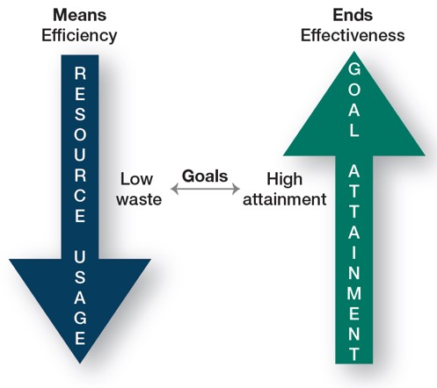
What Is Management? (2 of 2)
Exhibit 1.3 Efficiency and Effectiveness
Notes:
As illustrated here, while efficiency is concerned with the means of getting things done, effectiveness is concerned with the ends, or attainment of organizational goals.
The concepts are different, but interrelated. It’s easier to be effective if you ignore efficiency. Poor management is often due to both inefficiency and ineffectiveness OR effectiveness achieved without regard for efficiency.
Good management is concerned with both attaining goals (effectiveness) and doing so as efficiently as possible.
Long Description:
Efficiency is related to means and effectiveness is related to ends. Efficiency decreases resource usage, leading to low waste. Effectiveness increases goal attainment, leading to high attainment. Goals are influenced by low waste and high attainment.

Slide 12
Is the Manager’s Job Universal? (1 of 5)
Level in the Organization
Profit versus. Not-for-profit
Size of the Organization
Management Concepts and National Borders
Notes:
Until now, we’ve looked at management as a generic activity. If management is truly a generic discipline, then what a manager does should be essentially the same whether he or she is a top-level executive or a first-line supervisor, in a business firm or a government agency; in a large corporation or a small business; or located in Paris, Texas, or Paris, France. In reality, a manager’s job varies depending on several factors.

Slide 13
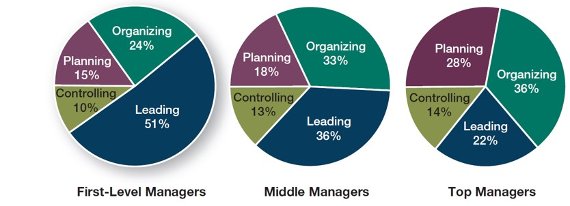
Is the Manager’s Job Universal? (2 of 5)
Level in the Organization
Exhibit 1.6 Management Activities by Organizational Level
Source: Based on T. A. Mahoney, T. H. Jerdee, and S. J. Carroll, “The Job(s) of Management,” Industrial Relations 4, n o. 2 (1965), p. 103
Notes:
First we’ll examine how a manager’s level in the organization impacts the role.
Although a supervisor and the C E O of a company may not do exactly the same things, it doesn’t mean that their jobs are inherently different. The differences are of degree and emphasis but not of activity. That is, the decisions of a top manager will have greater ramifications than those of a middle manager due to the content of the decision.
All managers regardless of level, make decisions and plan, lead, organize, and control. But the amount of time a manager gives to each activity is not necessarily constant. Also, the content of the managerial activities also changes with the manager’s level. The figure illustrates this variability.
Long Description:
The percent of activities performed by first-level managers are as follows. Leading: 51. Organizing: 24. Planning: 15. Controlling: 10. The percent of activities performed by middle managers are as follows. Leading: 36. Organizing: 33. Planning: 18. Controlling: 13. The percent of activities performed by top managers are as follows. Leading: 22. Organizing: 36. Planning: 28. Controlling: 14.

Slide 14
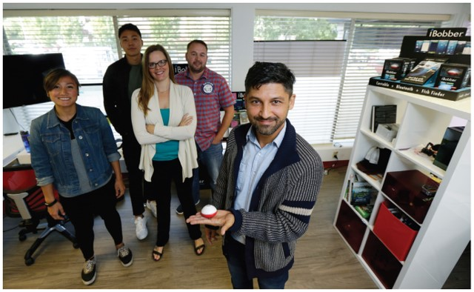
Is the Manager’s Job Universal? (3 of 5)
Profit versus. Not-for-profit
Notes:
The most important difference between the two is how performance is measured. Profit, or the “bottom line,” is an unambiguous measure of a business organization’s effectiveness. Not-for-profit organizations don’t have such a universal measure, making performance measurement more difficult. But even not-for-profit organizations need to make money to continue operating.

Slide 15
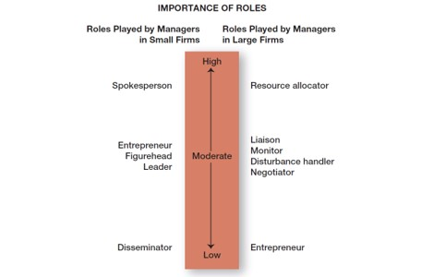
Is the Manager’s Job Universal? (4 of 5)
Size of the Organization
Exhibit 1.7 Managerial Roles in Small and Large Businesses
Source: Based on J. G. P. Paolillo, “The Manager’s Self-Assessments of Managerial Roles: Small versus. Large Firms,” American Journal of Small Business, January–March 1984, p p. 61–62
Notes:
As we see in this figure, managerial roles in small and large businesses differ.
For the purposes of our discussion, a small business is an independent business having fewer than 500 employees that doesn’t necessarily engage in any new or innovative practices and has relatively little impact on its industry.
The most important role of a small business manager is that of spokesperson, performing externally in meeting with customers, arranging financing with bankers, searching for new opportunities, and stimulating change.
The actions of a manager in a large organization, however, are directed internally, deciding which organizational units get which and how much of the available resources.
A small business manager is more likely to be a generalist in a less formal, less structured, and less complex environment than his counterpart in a large organization.
Again, as with organizational level, we see differences in degree and emphasis but not in the activities that managers do. Managers in both small and large organizations perform essentially the same activities, but how they go about those activities and the proportion of time they spend on each are different.
Long Description:
The roles played by managers in small firms, in the increasing level of importance, are as follows. Low: Disseminator. Moderate: Entrepreneur, figurehead, leader. High: Spokesperson. The roles played by managers in large firms, in the increasing level of importance, are as follows. Low: Entrepreneur. Moderate: Liaison, monitor, disturbance handler, negotiator. High: Resource allocator.

Slide 16
Is the Manager’s Job Universal? (5 of 5)
Management Concepts and National Borders
Notes:
If management concepts were transferable across countries, they would apply universally in all parts of the world. However, research shows that while concepts transfer easily among many English-speaking countries, management concepts will likely need to be modified when dealing with India, China, Chile, or other countries with economic, political, social, or cultural environments that differ from those of the so-called free-market democracies.

Slide 17
Learning Objective 1.3
Describe what managers do.

Slide 18
What Do Managers Do?
Ways to Look at What Managers Do
4 Functions Approach
Management Roles Approach
Skills and Competencies
Notes:
No two organizations are alike, and neither are managers’ jobs. But managers’ jobs do share some common elements. We’ll discuss three approaches to describing what managers do.

Slide 19
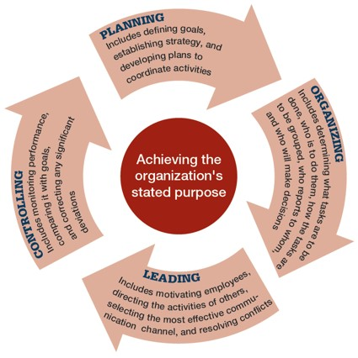
4 Functions Approach
Planning
Organizing
Leading
Controlling
Exhibit 1.4 Four Management Functions
Notes:
Managers perform certain activities, tasks, or functions as they direct and oversee others’ work. This approach was first proposed by French Industrialist Henri Fayol. He said managers engaged in five management activities: plan, organize, command, coordinate, and control (P O C C C). His choice of these five functions was based on his own observations of the mining industry, not from a formal survey. Today, those management functions have been condensed to the following four:
Planning includes defining goals, establishing strategy, and developing plans to coordinate activities.
Organizing includes determining which tasks need to be done and by whom, how tasks are to be grouped, who reports to whom, and who will make decisions.
Leading includes motivating employees, selecting the most effective communication channel, and resolving conflicts.
Controlling includes monitoring performance, comparing it with goals, and correcting any significant deviations.
Long Description:
The four functions are as follows. Planning: Includes defining goals, establishing strategy, and developing plans to coordinate activities. Organizing: Includes determining what tasks are to be done, who is to do them, how the tasks are to be grouped, who reports to who, and who will make decisions. Leading: Includes motivating employees, directing the activities of others, selecting the most effective communication channel, and resolving conflicts. Controlling: Includes monitoring performance, comparing it with goals, and correcting any significant deviations.

Slide 20
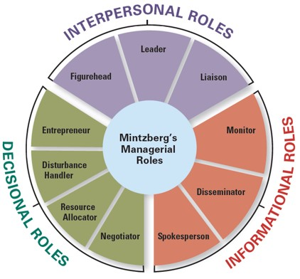
Management Roles Approach
Exhibit 1.5 Mintzberg’s Managerial Roles
Source: Based on Mintzberg, Henry, The Nature of Managerial Work, 1st edition, © 1973
Notes:
In the late 1960s, Henry Mintzberg dispelled long-held notions that managers were reflective thinkers who carefully processed information before making decisions. His empirical study of 5 chief executives showed that managers perform ten different but highly interrelated roles. He categorized these actions around the following three general categories:
Interpersonal relationships: Figurehead, leader, and liaison.
Informational transfer: Monitor, disseminator, and spokesperson.
Decision-making: Entrepreneur, disturbance handler, resource allocator, and negotiator.
Long Description:
The three types of roles are as follows. Interpersonal roles: Figurehead, leader, liaison. Informational roles: Spokesperson, disseminator, monitor. Decisional roles: Entrepreneur, disturbance handler, resource allocator, and negotiator.

Slide 21


Which Approach Takes the Prize?
Functions
Roles
Notes:
Both approaches seem to do a good job of describing what managers do. But, the functions approach wins! Its clarity and simplicity in describing what managers do make it continually popular.
But, don’t ignore Mintzberg’s roles approach; it does offer another way to describe what managers do.

Slide 22




Skills and Competencies
Analyze and diagnose
Working well with others
Possessing expert job knowledge
Political adeptness
Source: Simon/Fotolia
Notes:
Another way to describe what managers do is by looking at the skills they need for managing. Management researcher Robert L. Katz and others describe four critical skills:
Conceptual skills: Analyzing and diagnosing complex situations to see how things fit together and to facilitate making good decisions.
Interpersonal skills: Working well with other people both individually and in groups by communicating, motivating, mentoring, and delegating.
Technical skills: Job-specific knowledge, expertise, and techniques needed to perform work tasks. (For top-level managers − knowledge of the industry and a general understanding of the organization’s processes and products; For middle- and lower-level managers − specialized knowledge required in the areas where they work—finance, human resources, marketing, computer systems, manufacturing, information technology).
Political skills: Building a power base and establishing the right connections so they can get needed resources for their groups.

Slide 23
Learning Objective 1.4
Explain why it’s important to study management.

Slide 24
Why Study Management? (1 of 2)
We all have a vested interest in improving how organizations are managed.
Notes:
Why? Because we interact with them every day of our lives and an understanding of management offers insights into many organizational aspects. Understanding management offers insights into why some companies get our orders right the first time, why once-thriving organizations no longer exist, and which companies continue to prosper during challenging economic times.
Studying management provides knowledge about manager skills and responsibilities, how organizations function, and how people behave in the workplace.

Slide 25
Why Study Management? (2 of 2)
Most people will either manage or be managed.
Notes:
If you plan to be a manager, you’ll form a foundation on which to build your management skills and abilities. Even if you don’t see yourself managing, you’re still likely to have to work with managers. And the reality is, that if you plan to work for a living, you’ll probably have some managerial responsibilities even if you’re not a manager. Studying management provides knowledge about managerial skills and responsibilities, how organizations function, and how people behave in the workplace.

Slide 26
Learning Objective 1.5
Describe the factors that are reshaping and redefining management.

Slide 27

What Factors are Reshaping and Redefining Management
Welcome to the New World of Management!
Changing Workplaces + Changing Workforce
Notes:
Managers today are dealing with changing workplaces, a changing workforce, global economic and political uncertainties, and changing technology. Distributed labor companies are changing the face of temporary work. Some 30-45 percent of the world’s work force works from home or are virtual employees. More and more businesses are relying on apps and mobile-enhanced Websites to run their businesses.
Managers everywhere are likely to have to manage in changing circumstances, which means that how managers manage is changing. We will now look at four specific changes that are increasingly important to organizations and managers everywhere: customers, innovation, social media, and sustainability.

Slide 28
Why Are Customers Important to the Manager’s Job?
Consistent, high-quality customer service is essential to survival.
Notes:
Organizations depend on their customers to exist in the marketplace. Until recently, customer focus was thought to be the responsibility of marketing, but organizations are now discovering that employee attitudes and behaviors play a big role in customer satisfaction.
Managers are recognizing that delivering consistent high-quality customer service is essential for survival and success in today’s competitive environment. They recognize that employees are an integral part of creating a customer-responsive organization where employees are friendly, courteous, accessible, knowledgeable, prompt in responding to customer needs, and willing to do what’s necessary to please the customer.

Slide 29
Why Is Innovation Important to the Manager’s Job?
“Nothing is more risky than not innovating.”
Notes:
Innovation means doing things differently, exploring new territory, and taking risks.
In today’s challenging environment, innovation is critical and managers need to understand what, when, where, how, and why innovation can be fostered and encouraged throughout an organization. Managers need to be personally innovative and to encourage their employees to be innovative.

Slide 30

Importance of Social Media to the Manager’s Job
Social media
  Forms of electronic communication through which users create communities to share ideas, information, personal messages, and other content
Connecting with customers
Managing human resources
Notes:
More than a billion people use social media platforms like Facebook, Twitter, YouTube, LinkedIn, etc. Managers need to understand and manage the power of social media, because employees use them for both personal and work purposes. More and more businesses are turning to social media not just as a way to connect with customers but also as a way to manage their human resources and tap into their innovation and talent. But it’s not without its perils. Managers need to remember that social media is a tool that needs to be managed to be beneficial.

Slide 31
Importance of Sustainability to the Manger’s Job
Sustainability
  A company’s ability to achieve its business goals and increase long-term shareholder value by integrating economic, environmental, and social opportunities into its business strategies
Notes:
Another twenty-first century challenge is managing in a sustainable way. This means not just managing efficiently and effectively, but also responding strategically to environmental and societal challenges. Sustainability can be defined as meeting the needs of people today without compromising the ability of future generations to meet their own needs. From a business perspective, sustainability refers to a company’s ability to achieve its business goals and increase long-term shareholder value by integrating economic, environmental, and social opportunities into its business strategies.

Slide 32
Learning Objective 1.6
Describe the key employability skills gained from studying management that are applicable to your future career, regardless of your major

Slide 33
What Employability Skills Are Critical for Getting and Keeping a Job?
Critical thinking
Communication
Collaboration
Knowledge application and analysis
Social responsibility
Notes:
Studying management can help you develop and improve your attractiveness as an employee.

Slide 34
Managers Matter!
Employee productivity, loyalty, and engagement hinge on employee/manager relationships.
Employee engagement
  When employees are connected to, satisfied with, and enthusiastic about their jobs
Notes:
The Gallup Organization, which has polled millions of employees and tens of thousands of managers, has found that the single most important variable in employee productivity and loyalty isn’t pay or benefits or workplace environment; it’s the quality of the relationship between employees and their direct supervisors.
Gallup also found that the relationship with their manager is the largest factor in employee engagement —which is when employees are connected to, satisfied with, and enthusiastic about their jobs—accounting for at least 70 percent of an employee’s level of engagement.

Slide 35

Copyright
This work is protected by United States copyright laws and is provided solely for the use of instructors in teaching their courses and assessing student learning. Dissemination or sale of any part of this work (including on the World Wide Web) will destroy the integrity of the work and is not permitted. The work and materials from it should never be made available to students except by instructors using the accompanying text in their classes. All recipients of this work are expected to abide by these restrictions and to honor the intended pedagogical purposes and the needs of other instructors who rely on these materials.

